Slide 1
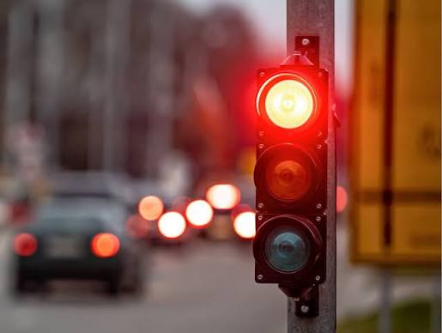
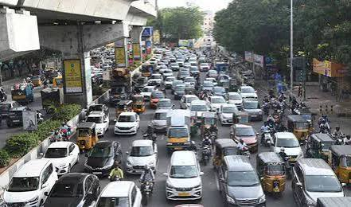
DESIGN AND SIMULATION OF AN INTELLIGENT TRAFFIC SIGNAL DECISION SYSTEM USING COMBINATIONAL LOGIC
Presented by under the Supervisor:
Group details: Rahul LR sir
GUDURU SAHASRA 2620090001 subject: DDCA
AKSHAYA MARRI 2620090011
S N DARSHAN 2620090099
E V VARA PRASAD 2620030676

Slide 2
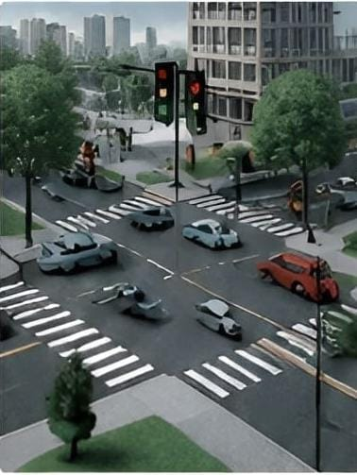
INTRODUCTION
Traffic congestion at intersections is a major issue in urban areas. An Intelligent Traffic Signal Decision System adjusts the signal timing based on the presence of vehicles in different directions.
This project uses combinational logic to design a smart traffic signal controller that gives priority to the direction with higher vehicle density. reducing unnecessary waiting time.

Slide 3
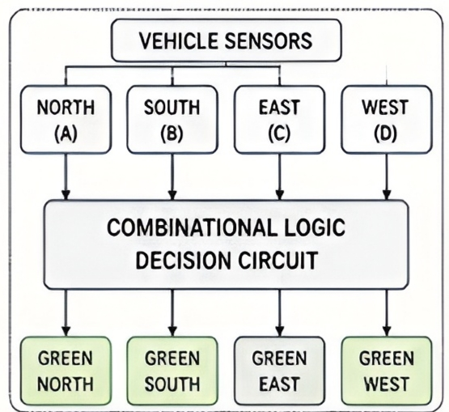
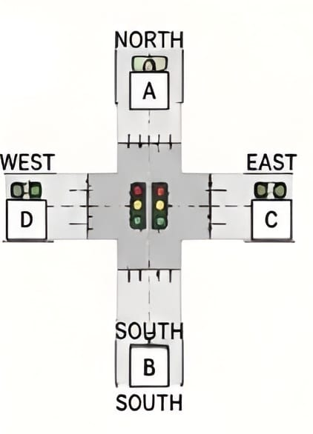
2.OBJECTIVE
To design a combinational logic circuit that decides which direction gets Green signal.
To reduce waiting time by giving priority based on vehicle presence.
To simulate and verify the system using logic simulation software.
To make the traffic flow more efficient and reduce congestion
3.SYSTEM DESCRIPTION
Each road direction (North, South, East, West) has a vehicle sensor.
Sensor output = 1→ Vehicle present
Sensor output = 0→ No vehicle
The combinational logic circuit decides which direction gets Green. Only one direction is given Green at a time; others get Red.
Priority is given in the order: North > South > East > West(if multiple directions have vehicles)

Slide 4
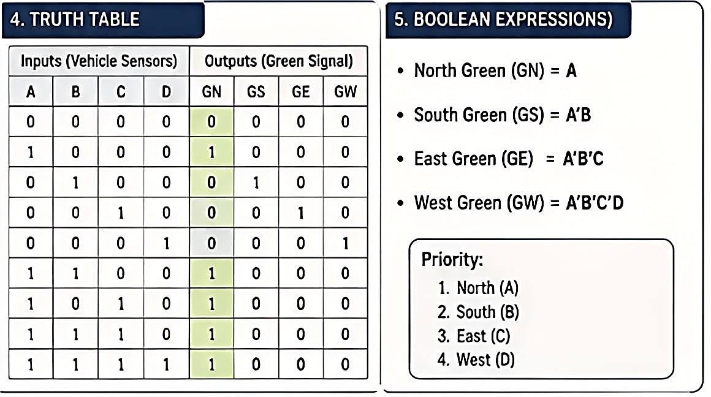
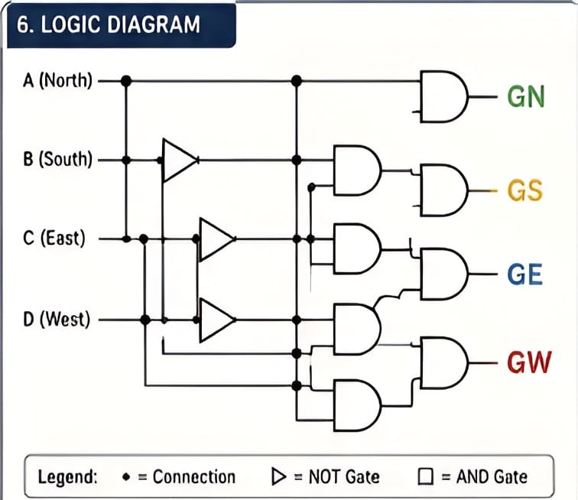
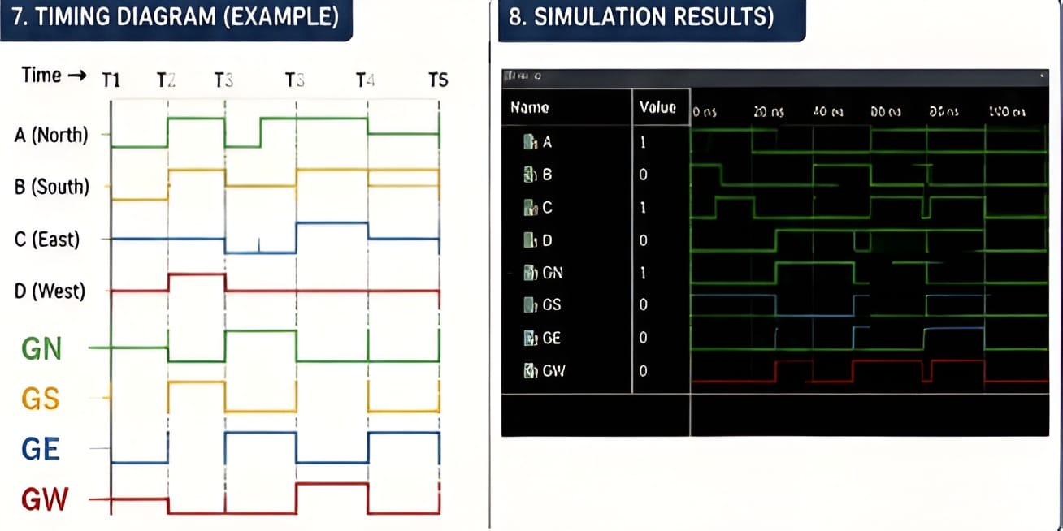

Slide 5
